Slide 1


CSCE 5610
Computer System Architecture
The Processor

Slide 2
Content
Single-cycle implementation
All operations take the same amount of time—a single cycle.
Multicycle implementation
Allows faster operations to take less time than slower ones, so overall performance can be increased.
Pipelining
Lets a processor overlap the execution of several instructions, potentially leading to big performance gains.

Slide 3
Single-cycle implementation
We will describe the implementation a simple MIPS-based instruction set supporting just the following operations.
Arithmetic: | add | sub | and | or | slt
Data Transfer: | lw | sw
Control: | beq
Today we’ll build a single-cycle implementation of this instruction set.
All instructions will execute in the same amount of time; this will determine the clock cycle time for our performance equations.
We’ll explain the datapath first, and then make the control unit.

Slide 4
Computers are state machines
A computer is just a big fancy state machine.
Registers, memory, hard disks and other storage form the state.
The processor keeps reading and updating the state, according to the
instructions in some program.
CPU
State

Slide 5
Instruction fetching
The CPU is always in an infinite loop, fetching instructions from memory and executing them.
The program counter or PC register holds the address of the current instruction.
Add
P C
4
Read Instruction address [31-0]
Instruction memory

Slide 6
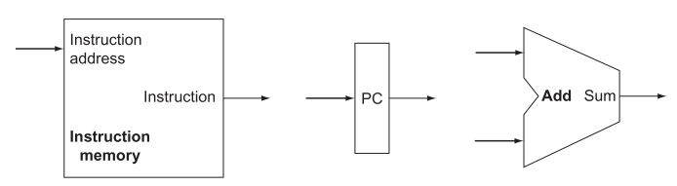
Basic MIPS implementation
The first two steps for every instruction:
Send PC to instruction memory
Read one or two registers using fields in the machine code
Instruction Memory: stores the code and supply instruction given an address
Program Counter (PC): holds the address of the current instruction
Adder: increments the PC to the address of the next instruction

Slide 7
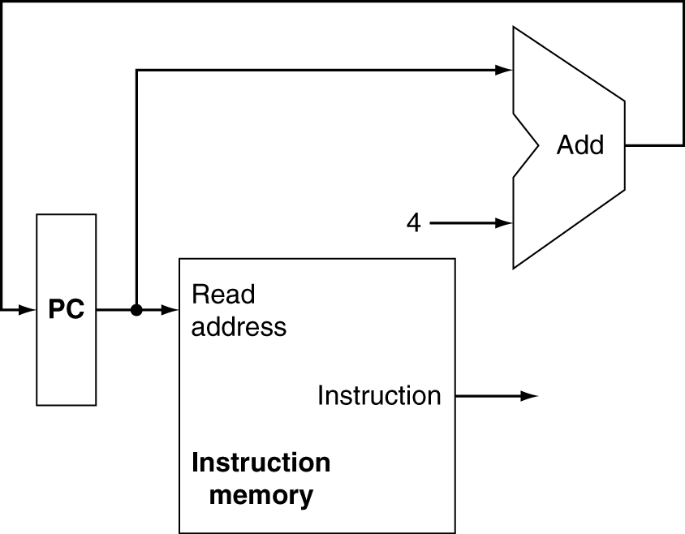
Building a datapath: Fetch
To execute any instruction:
Fetch the instruction from memory
Increment the PC to point at the next instruction
PC+4
Why?
32-bit Machine Code

Slide 8
Encoding R-type instructions
Last lecture, we saw encodings of MIPS instructions as 32-bit values.
Register-to-register arithmetic instructions use the R-type format.
op is the instruction opcode, and func specifies a particular arithmetic
operation.
rs, rt and rd are source and destination registers.
op | rs | rt | rd | shamt | func
6 bits | 5 bits | 5 bits | 5 bits | 5 bits | 6 bits
An example instruction and its encoding:
add $20, $9, $10
000000 | 01001 | 01010 | 10100 | 00000 | 1000000

Slide 9
Registers and ALUs
R-type instructions must access registers and an ALU.
RegWrite
Our register file stores thirty-two 32-bit values.
Each register specifier is 5 bits long.
You can read from two registers at a time.
RegWrite is 1 if a register should be written.
Read register 1
Read register 2
Write register
Write data
Read data 1
Read data 2
Registers
Here’s a simple ALU with five operations, selected by a 3-bit control signal ALUOp.
ALUOp | Function
000 | and
001 | or
010 | add
110 | subtract
111 | slt
ALU
ALUOp

Slide 10
Executing an R-type instruction
Read an instruction from the instruction memory.
The source registers, specified by instruction fields rs and rt, should be
read from the register file.
The ALU performs the desired operation.
Its result is stored in the destination register, which is specified by field rd of the instruction word.
RegWrite
Read Instruction
address [31-0]
Instruction memory
I [25 - 21]
Read
register 1
Read register 2
Write register
Write data
Read data 1
ALU
Zero
Result
I [20 - 16]
Read data 2
Registers
I [15 - 11]
ALUOp
op | rs | rt | rd | shamt | func
31 26 | 25 21 | 20 16 | 15 11 | 10 6 | 5 0

Slide 11
Encoding I-type instructions
The lw, sw and beq instructions all use the I-type encoding.
rt is the destination for lw, but a source for beq and sw.
address is a 16-bit signed constant.
op | rs | rt | address
6 bits | 5 bits | 5 bits | 16 bits
Two example instructions:
lw $t0, –4($sp) sw $a0, 16($sp)
100011 | 11101 | 01000 | 1111 1111 1111 1100
101011 | 11101 | 00100 | 0000 0000 0001 0000

Slide 12
Accessing data memory
For an instruction like lw $t0, –4($sp), the base register $sp is added to the sign-extended constant to get a data memory address.
This means the ALU must accept either a register operand for arithmetic instructions, or a sign-extended immediate operand for lw and sw.
We’ll add a multiplexer, controlled by ALUSrc, to select either a register operand (0) or a constant operand (1).
RegWrite
Read Instruction address [31-0]
I [25 - 21]
MemWrite
MemToReg
Read
register 1
Read register 2
Write register
Write data
Read data 1
ALU
Read Read
1
M
u
I [20 - 16]
Zero Result
address data Write
address
Data
Instruction memory
0
M
u x
1
Read data 2
Registers
0
M
u x
1
x
0
Write data
memory
I [15 - 11]
ALUOp
RegDst I [15 - 0]
ALUSrc
MemRead
Sign extend
lw $t0, –4($sp)
100011 | 11101 | 01000 | 1111 1111 1111 1100

Slide 13
MemToReg
The register file’s ― “Write data" input has a similar problem. It must b e able to store either the ALU output of R-type instructions, or the data memory output for lw.
We add a mux, controlled by MemToReg, to select between saving the ALU result (0) or the data memory output (1) to the registers.
RegWrite
Read Instruction address [31-0]
Instruction memory
I [25 - 21]
MemWrite
MemToReg
Read
register 1
Read register 2
Write register
Write data
Read data 1
ALU
Read Read
1
M
u
I [20 - 16]
Zero Result
address data Write
address
Data
0
M
u x
1
Read data 2
Registers
0
M
u x
1
x
0
Write data
memory
I [15 - 11]
ALUOp
RegDst I [15 - 0]
ALUSrc
MemRead
Sign extend

Slide 14
RegDst
A final annoyance is the destination register of lw is in rt instead of rd.
lw $rt, address($rs)
We’ll add one more mux, controlled by RegDst, to select the destination register from either instruction field rt (0) or field rd (1).
RegWrite
op | rs | rt | address
Read Instruction
address [31-0]
 |  | I [20 -
Instruction
memory
MemWrite
MemToReg
I [25 - 21]
Read
register 1
Read register 2
Write register
Write data
Read data 1
ALU
Read Read
1
M
u
16]
Zero Result
address data Write
address
Data
0
M
u x
1
Read data 2
Registers
0
M
u x
1
x
0
Write data
memory
I [15 - 11]
ALUOp
RegDst I [15 - 0]
ALUSrc
MemRead
Sign extend

Slide 15

Branches
For branch instructions, the constant is not an address but an instruction offset from the current program counter to the desired address.
beq | $at, $0, L
add | $v1, $v0, | $0
add | $v1, $v1, | $v1
j | Somewhere
L: add | $v1, $v0, | $v0
The target address L is three instructions past the beq, so the encoding of the branch instruction has 0000 0000 0000 0011 for the address field.
000100 | 00001 | 00000 | 0000 0000 0000 0011
op | rs | rt | address
Instructions are four bytes long, so the actual memory offset is 12 bytes.

Slide 16
The steps in executing a beq
Fetch the instruction, like beq $at, $0, offset, from memory.
Read the source registers, $at and $0, from the register file.
Compare the values by subtracting them in the ALU.
If the subtraction result is 0, the source operands were equal and the PC should be loaded with the target address, PC + 4 + (offset x 4).
Otherwise the branch should not be taken, and the PC should just be incremented to PC + 4 to fetch the next instruction sequentially.

Slide 17

Branching hardware
We need a second adder, since the ALU is already doing subtraction for the beq.
0
M
u
PCSrc=1 branches
to PC+4+(offset 4).
PCSrc=0 continues to PC+4.
PC
Add
x
1
4
Multiply constant
by 4 to get offset.
Add
Shift left 2
PCSrc
RegWrite
Read Instruction address [31-0]
Instruction memory
I [25 - 21]
MemWrite
MemToReg
Read register 1
Read register 2
Write register
Write data
Read data 1
ALU
Read Read
1
M
u
I [20 - 16]
Zero
Result
address data Write
address
Data
0
M
u x
1
Read data 2
Registers
0
M
u x
1
x
0
Write data
memory
I [15 - 11]
ALUOp
RegDst I [15 - 0]
ALUSrc
MemRead
Sign
extend

Slide 18
Control
The control unit is responsible for setting all the control signals so that each instruction is executed properly.
The control unit’s input is the 32-bit instruction word.
The outputs are values for the blue control signals in the datapath.
Most of the signals can be generated from the instruction opcode alone, and not the entire 32-bit word.
To illustrate the relevant control signals, we will show the route that is taken through the datapath by R-type, lw, sw and beq instructions.

Slide 19
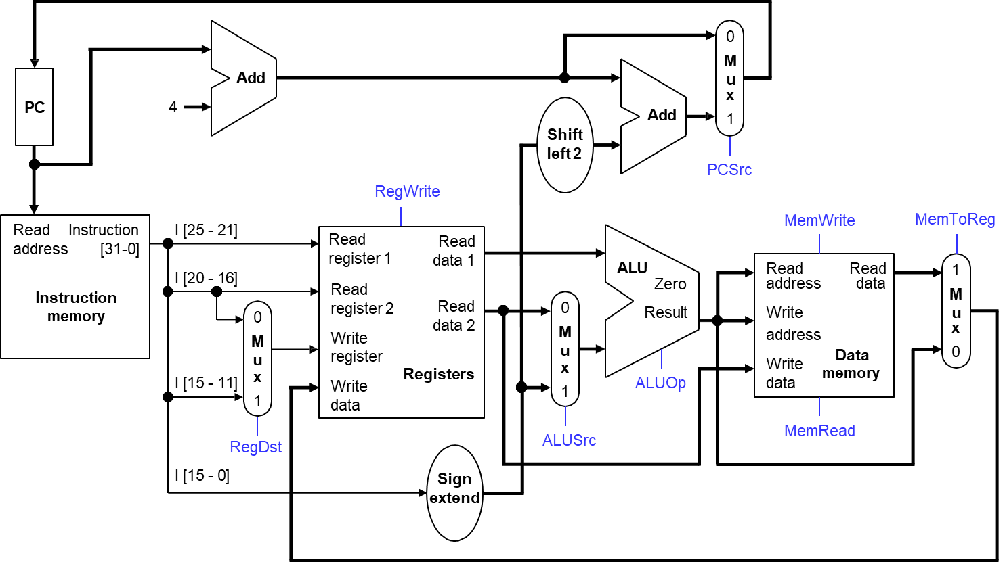
R-type instruction path
The R-type instructions include add, sub, and, or, and slt.
The ALUOp is determined by the instruction’s ―"func” field.

Slide 20
lw instruction path
An example load instruction is lw $t0, –4($sp).
The ALUOp must be 010 (add), to compute the effective address.
0
M
u
PC
Add
x
1
4
Add
Shift left 2
PCSrc
RegWrite
Read Instruction address [31-0]
Instruction
memory
I [25 - 21]
MemWrite
MemToReg
Read register 1
Read
register 2
Write register
Write data
Read data 1
ALU
Read Read
1
M
u
I [20 - 16]
Zero Result
address data Write
address
Data
0
M
u x
1
Read data 2
Registers
0
M
u x
1
x
0
Write data
memory
I [15 - 11]
ALUOp
RegDst I [15 - 0]
ALUSrc
MemRead
Sign extend

Slide 21
sw instruction path
An example store instruction is sw $a0, 16($sp).
The ALUOp must be 010 (add), again to compute the effective address.
0
M
u
PC
Add
x
1
4
Add
Shift left 2
PCSrc
RegWrite
Read Instruction address [31-0]
Instruction
memory
I [25 - 21]
MemWrite
MemToReg
Read register 1
Read
register 2
Write register
Write data
Read data 1
ALU
Read Read
1
M
u
I [20 - 16]
Zero Result
address data Write
address
Data
0
M
u x
1
Read data 2
Registers
0
M
u x
1
x
0
Write data
memory
I [15 - 11]
ALUOp
RegDst I [15 - 0]
ALUSrc
MemRead
Sign extend

Slide 22
beq instruction path
One sample branch instruction is beq $at, $0, offset.
The ALUOp is 110 (subtract), to test for equality.
The branch may or may not be taken, depending on the ALU’s Zero output
0
M
u
PC
Add
x
1
4
Add
Shift left 2
PCSrc
RegWrite
Read Instruction address [31-0]
Instruction
memory
I [25 - 21]
MemWrite
MemToReg
Read register 1
Read
register 2
Write register
Write data
Read data 1
ALU
Read Read
1
M
u
I [20 - 16]
Zero Result
address data Write
address
Data
0
M
u x
1
Read data 2
Registers
0
M
u x
1
x
0
Write data
memory
I [15 - 11]
ALUOp
RegDst I [15 - 0]
ALUSrc
MemRead
Sign extend
0, if branch not-taken
PCSrc =
1, if branch taken

Slide 23
Control Signal Table
Operation | RegDst | RegWrite | ALUSrc | ALUOp | MemWrite | MemRead | MemToReg
add | 1 | 1 | 0 | 010 | 0 | 0 | 0
sub | 1 | 1 | 0 | 110 | 0 | 0 | 0
and | 1 | 1 | 0 | 000 | 0 | 0 | 0
or | 1 | 1 | 0 | 001 | 0 | 0 | 0
slt | 1 | 1 | 0 | 111 | 0 | 0 | 0
lw | 0 | 1 | 1 | 010 | 0 | 1 | 1
sw | X | 0 | 1 | 010 | 1 | 0 | X
beq | X | 0 | 0 | 110 | 0 | 0 | X
sw and beq are the only instructions that do not write any registers.
lw and sw are the only instructions that use the constant field. They also depend on the ALU to compute the effective memory address.
ALUOp for R-type instructions depends on the instructions’ func field.
The PCSrc control signal (not listed) should be set if the instruction is beq
and the ALU’s Zero output is true.

Slide 24
Generating Control Signals
The control unit needs 13 bits of inputs.
Six bits make up the instruction’s opcode.
Six bits come from the instruction’s func field.
It also needs the Zero output of the ALU.
The control unit generates 10 bits of output, corresponding to the signals mentioned on the previous page.
RegDst RegWrite
ALUSrc ALUOp
MemWrite MemRead MemToReg
PCSrc
Read Instruction address [31-0]
Instruction memory
I [31 - 26]
I [5 - 0]
Control
Zero

Slide 25
Single-Cycle Performance
We saw a MIPS single-cycle datapath and control unit.
Then, we’ll explore factors that contribute to a processor’s execution time, and specifically at the performance of the single-cycle machine.
Next, we’ll explore how to improve on the single cycle machine’s performance using pipelining.

Slide 26
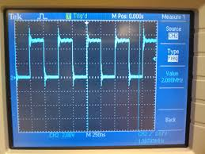
Processor clock period
the processor clock oscillates between high and low signal levels:
Clock Signal
1.2 Volts
0 Volts
Time
Clock Cycle 1
Clock Cycle 2
Clock Cycle 3
Clock Cycle 4
Oscilloscope Operation
the clock synchronizes the processor’s operations on rising & falling edges:
a register updates contents upon arrival of clock edge
a processor starts instruction execution at clock edge
Clock Period = Clock Cycle Time
interval of time between 2 adjacent rising edges
duration of 1 cycle of the clock signal
clock period has units of seconds (nanoseconds, microseconds, or picoseconds)

Slide 27
Edge-triggered State Elements
In an instruction like add $t1, $t1, $t2, how do we know $t1 is not updated until after its original value is read?
We’ll assume that our state elements are positive edge triggered, and are updated only on the positive edge of a clock signal.
The register file and data memory have explicit write control signals, RegWrite and MemWrite. These units can be written to only if the control signal is asserted and there is a positive clock edge.
In a single-cycle machine the PC is updated on each clock cycle, so we don’t bother to give it an explicit write control signal.
RegWrite
Read register 1
Read register 2
Write register
Write data
Read data 1
Read data 2
Registers
MemWrite
Read Read
address data Write
address
Data
Write data
memory
MemRead
PC

Slide 28
Processor Frequency
Clock Frequency = 1 / (Clock Period)
a CPU’s Clock Frequency is the inverse of it’s Clock Cycle time
Cycle 1
Cycle 2
Cycle 3
one clock period
the number of clock cycles occurring in 1 second
measured in units of Hertz (Hz)
also called the Clock Rate
F = 1 / Period
10 nsec clock cycle period → 100 MHz clock rate
5 nsec clock cycle period → 200 MHz clock rate
2 nsec clock cycle period → 500 MHz clock rate
1 nsec (10⁻⁹) clock cycle period → 1 GHz (10⁹) clock rate
500 psec clock cycle period → 2 GHz clock rate
250 psec clock cycle period → 4 GHz clock rate
200 psec clock cycle period → 5 GHz clock rate
When designing processors, we work in units of:
Nanoseconds
or
GHz

Slide 29
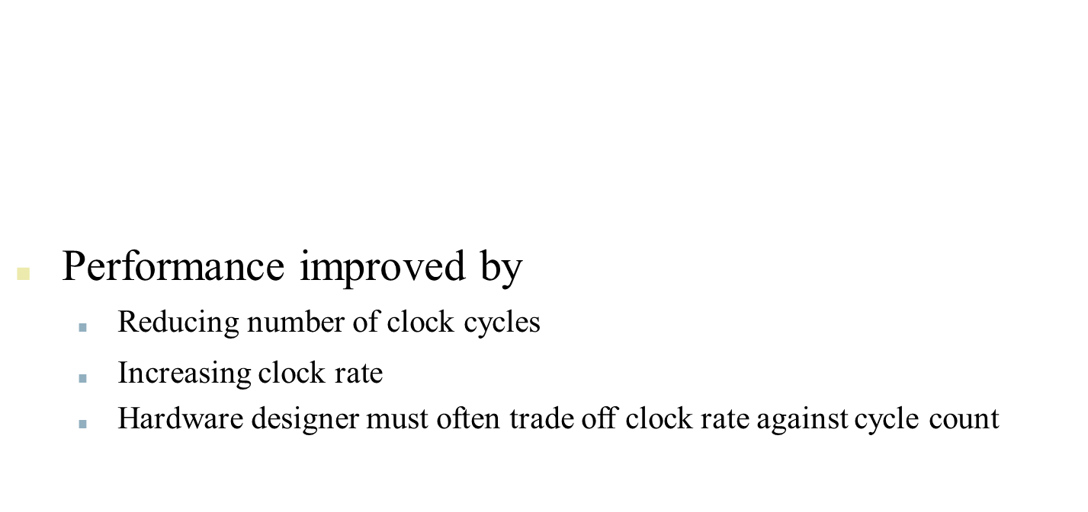
CPU Time
Performance improved by
Reducing number of clock cycles
Increasing clock rate
Hardware designer must often trade off clock rate against cycle count
$$CPU time=CPU Clock Cycles∗Cycle Time=\frac{Clock Cycles}{Clock Rate}$$

Slide 30
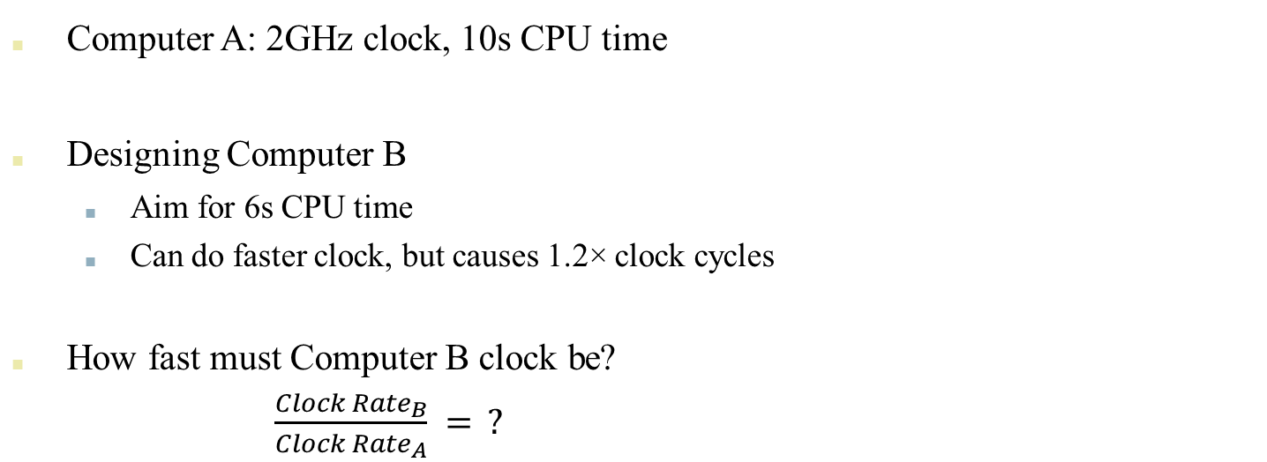
CPU Time Exercise
$$CPU time=CPU Clock Cycles∗Cycle Time=\frac{Clock Cycles}{Clock Rate}$$
Computer A: 2GHz clock, 10s CPU time
Designing Computer B
Aim for 6s CPU time
Can do faster clock, but causes 1.2× clock cycles
How fast must Computer B clock be?
$\frac{{Clock Rate}_{B}}{{Clock Rate}_{A}} = ?$

Slide 31
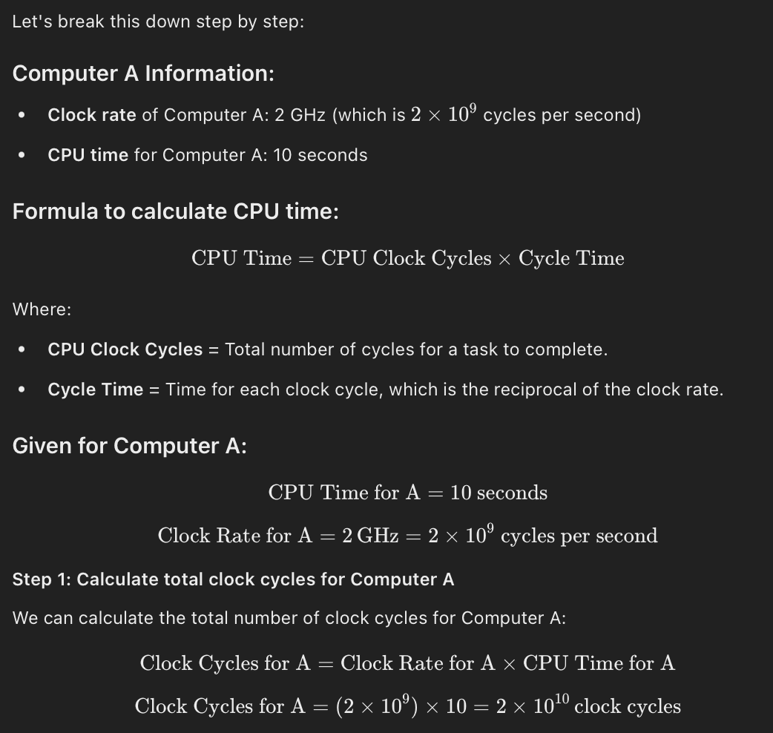

Slide 32
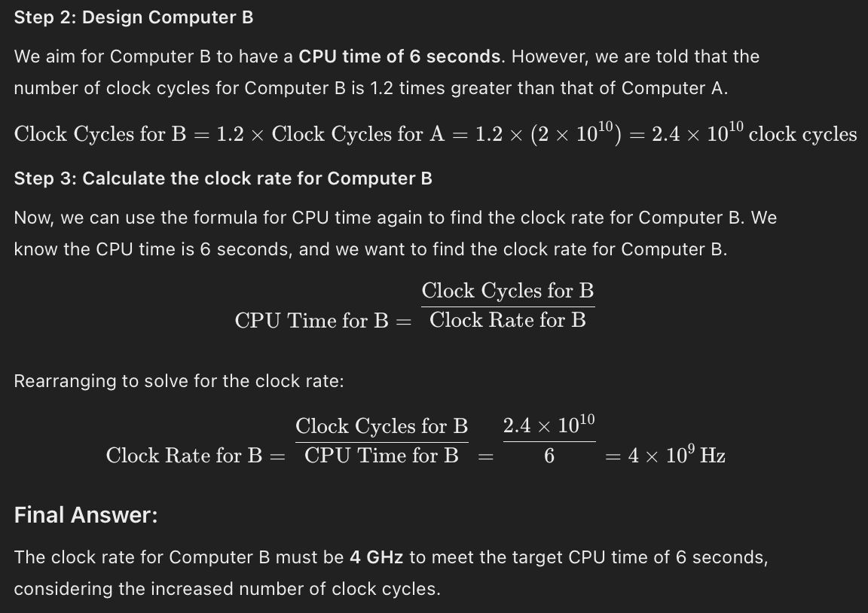

Slide 33
CPI-Cycles per Instruction
The average number of clock cycles per instruction, or CPI, is a function of the machine and program.
The CPI depends on the actual instructions appearing in the program— a floating-point intensive application might have a higher CPI than an integer-based program.
It also depends on the CPU implementation. For example, a Pentium can execute the same instructions as an older 80486, but faster.
We assumed each instruction took one cycle, so we had CPI = 1.
The CPI can be >1 due to memory stalls and slow instructions.
The CPI can be <1 on machines that execute more than 1 instruction per cycle (superscalar).

Slide 34


CPU Time
$$CPU time=Instructions executed∗CPI∗Cycle Time$$

Slide 35

Instructions Executed
Instructions executed:
We are not interested in the static instruction count, or how many
lines of code are in a program.
Instead we care about the dynamic instruction count, or how many instructions are actually executed when the program runs.
li $4,
subi $4,
bne $4,
1000
$4, 1
$0, Ostrich
Ostrich:

Slide 36
Instructions Executed
Instructions executed:
We are not interested in the static instruction count, or how many
lines of code are in a program.
Instead we care about the dynamic instruction count, or how many instructions are actually executed when the program runs.
There are three lines of code below, but the number of instructions executed would be 2001.
li $4,
subi $4,
bne $4,
1000
$4, 1
$0, Ostrich
Ostrich:

Slide 37
Clock Cycle Time
One "cycle" is the minimum time it takes the CPU to do any work.
The clock cycle time or clock period is just the length of a cycle.
The clock rate, or frequency, is the reciprocal of the cycle time.
Generally, a higher frequency is better.
Some examples illustrate some typical frequencies.
A 500MHz processor has a cycle time of 2ns.
A 2GHz (2000MHz) CPU has a cycle time of just 0.5ns.

Slide 38
How does add go through the datapath
0
M
u
PC
Add
x
1
4
Add
Shift left 2
PCSrc
RegWrite
Read Instruction address [31-0]
Instruction
memory
I [25 - 21]
MemWrite
MemToReg
Read register 1
Read
register 2
Write register
Write data
Read data 1
ALU
Read Read
1
M
u
I [20 - 16]
Zero Result
address data Write
address
Data
0
M
u x
1
Read data 2
Registers
0
M
u x
1
x
0
Write data
memory
I [15 - 11]
ALUOp
RegDst I [15 - 0]
ALUSrc
MemRead
Sign extend

Slide 39
Compute the longest path in the add instruction
PC+4
0
M
u
PC
Add
x
1
4
Add
2 ns
Shift left 2
PCSrc
0 ns
RegWrite
2 ns
Read Instruction
address [31-0]
Instruction memory
I [25 - 21]
MemWrite
MemToReg
Read register 1
Read register 2
Write register
Write data
Read data 1
ALU
Read Read
1
M
u x
0
I [20 - 16]
Zero Result
address data Write
address
Data
0
M
u
x
1
Read data 2
Registers
0
M
u x
1
ALUOp
2 ns
Write
data
memory
2 ns
I [15 - 11]
0 ns
1 ns
ALUSrc
MemRead
RegDst I [15 - 0] 0 ns
Sign extend
0 ns
2 ns

Slide 40
The Slowest Instruction...
If all instructions must complete within one clock cycle, then the cycle time has to be large enough to accommodate the slowest instruction.
For example, lw $t0, –4($sp) is the slowest instruction needing ___ns.
— Assuming the circuit latencies below.
Read Instruction address [31-0]
Instruction memory
I [25 - 21]
Read register 1
Read
register 2
Write register
Write data
Read data 1
ALU
Read Read
1
M
u x
0
0 ns
I [20 - 16]
Zero Result
address data Write
address
Data
0
M
u x
1
Read data 2
Registers
0
M
u x
1
0 ns
2 ns
2 ns
Write data
memory
I [15 - 11]
2 ns
0 ns
1 ns
I [15 - 0]
Sign extend
0 ns

Slide 41
The Slowest Instruction...
If all instructions must complete within one clock cycle, then the cycle time has to be large enough to accommodate the slowest instruction.
For example, lw $t0, –4($sp) is the slowest instruction needing ___ns.
— Assuming the circuit latencies below.
reading the instruction memory 2ns
reading the base register $sp 1ns computing memory address $sp-4 2ns
reading the data memory 2ns
storing data back to $t0 1ns
8ns
Read Instruction address [31-0]
Instruction memory
I [25 - 21]
Read register 1
Read
register 2
Write register
Write data
Read data 1
ALU
Read Read
1
M
u x
0
0 ns
I [20 - 16]
Zero Result
address data Write
address
Data
0
M
u x
1
Read data 2
Registers
0
M
u x
1
0 ns
2 ns
2 ns
Write data
memory
I [15 - 11]
2 ns
0 ns
1 ns
I [15 - 0]
Sign extend
0 ns

Slide 42
...Determines the Clock Cycle Time
If we make the cycle time 8ns then every instruction will take 8ns, even if they don’t need that much time.
For example, the instruction add $s4, $t1, $t2 really needs just 6ns.
reading the instruction memory 2 ns
reading registers $t1 and $t2 1 ns computing $t1 + $t2 2 ns
storing the result into $s0 1 ns
6 ns
Read Instruction address [31-0]
Instruction memory
I [25 - 21]
Read register 1
Read register 2
Write
register
Write data
Read data 1
ALU
Read Read
1
M
u x
0
0 ns
I [20 - 16]
Zero Result
address data Write
address
Data
0
M
u x
1
Read data 2
Registers
0
M
u x
1
0 ns
2 ns
2 ns
Write data
memory
I [15 - 11]
2 ns
0 ns
1 ns
I [15 - 0]
Sign extend
0 ns

Slide 43




How bad is this?
With these same component delays, a sw instruction would need 7ns, and beq would need just 5ns.
Let’s consider the gcc instruction mix.
Instruction | Frequency
Arithmetic | 48%
Loads | 22%
Stores | 11%
Branches | 19%
With a single-cycle datapath, each instruction would require 8ns.
But if we could execute instructions as fast as possible, the average time per instruction for gcc would be?

Slide 44
How bad is this?
With these same component delays, a sw instruction would need 7ns, and beq would need just 5ns.
Let’s consider the gcc instruction mix.
Instruction | Frequency
Arithmetic | 48%
Loads | 22%
Stores | 11%
Branches | 19%
With a single-cycle datapath, each instruction would require 8ns.
But if we could execute instructions as fast as possible, the average time per instruction for gcc would be?
(48% x 6ns) + (22% x 8ns) + (11% x 7ns) + (19% x 5ns) = 6.36ns
The single-cycle datapath is about 1.26 times slower!

Slide 45


